Slide 1
Texas Tech University Health Sciences Center
Purchasing quarterly meeting
Ttuhsc pURCHASING

Slide 2
Agenda
Purchasing Staff Transition
Purchasing Contact Information
purchasing@ttuhsc.edu
SciQuest generated emails
New Purchasing Website
Training documents
Forms
Techbuy
Profile
Shopping Carts
History Tab
Funding splits
Advance pay/Recur payments
PO/Encumbrance Change Requests
More descriptive comments
Recur increases
TTUHSC Direct Pay Forms
Questions and Answer Period

Slide 3
Purchasing Staff Transition
Teri Floyd and Juan Lucero are no longer with TTUHSC Purchasing. If you have questions on orders they processed please contact purchasing. Purchasing@ttuhsc.edu
Purchasing Contact Information
Please make sure to use the correct Purchasing inbox email address: Purchasing@ttuhsc.edu
System Generated emails – DO NOT hit reply to system generated emails (emails that come from SciQuest). Sciquest emails are monitored by TTU staff and only one HSC staff member. Please create a new email or forward email to Purchasing@ttuhsc.edu

Slide 4
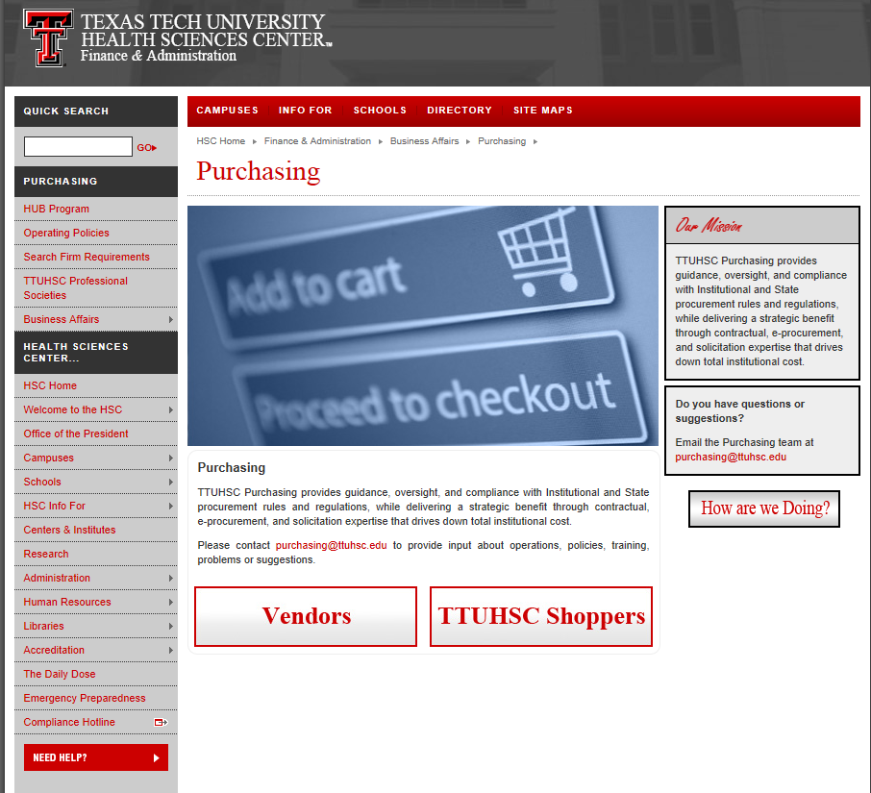
New Purchasing Website
Purchasing has updated their website. It is located at the same address: http://www.fiscal.ttuhsc.edu/purchasing/

Slide 5
To enter the website first you will select if you are a vendor or a TTUHSC Shopper by clicking on the appropriate button.
Click Vendors or
TTUHSC Shopper

Slide 6
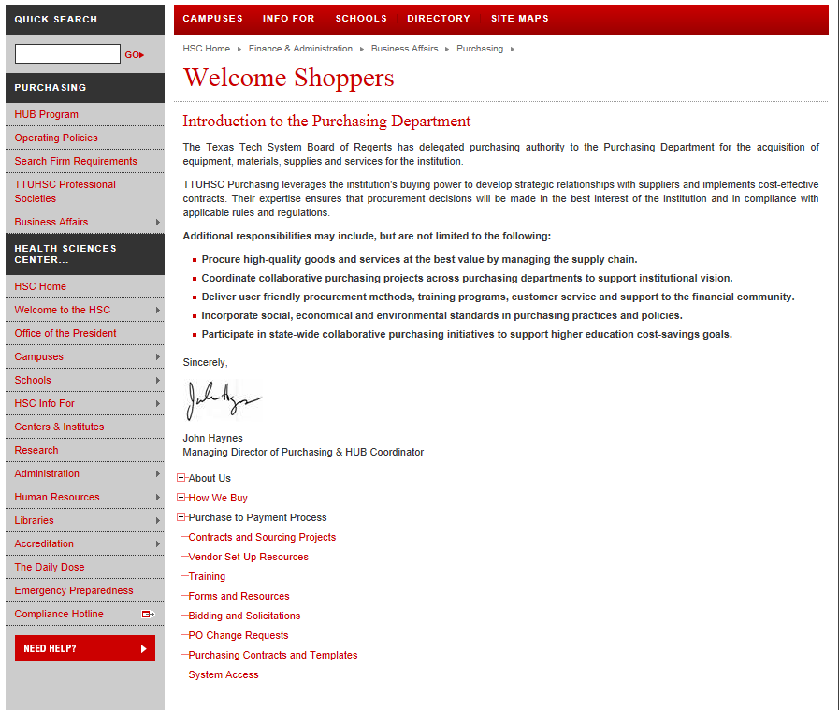
The shoppers page contains links to information to help shoppers understand the purchasing process.

Slide 7
The training tab provides several training documents with step by step instructions.
Click Training

Slide 8
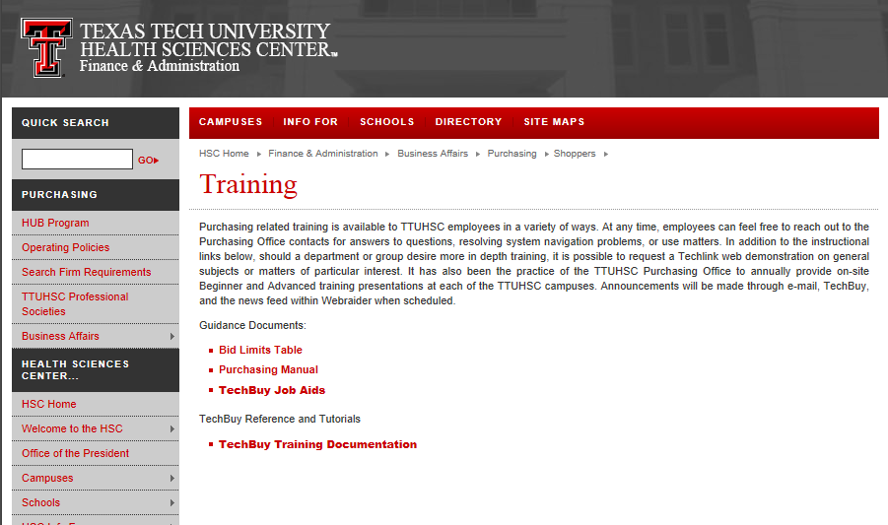
TechBuy Job Aids and the TechBuy Training Documentation both provide step by step instructions.

Slide 9
The Forms and Resources link provides forms and links to other useful resources.
Click Forms and Resources

Slide 10
The vendors page contains links to information needed for vendors to do business with TTUHSC.

Slide 11
TechBuy Profile
To view your profile select your name in the top panel. Click view my profile.

Slide 12
Verify all contact information is correct (phone number and department).

Slide 13
Click on default addresses to verify you have the correct default set up. Some punch-out sites require a default ship to in order to enter their site.

Slide 14
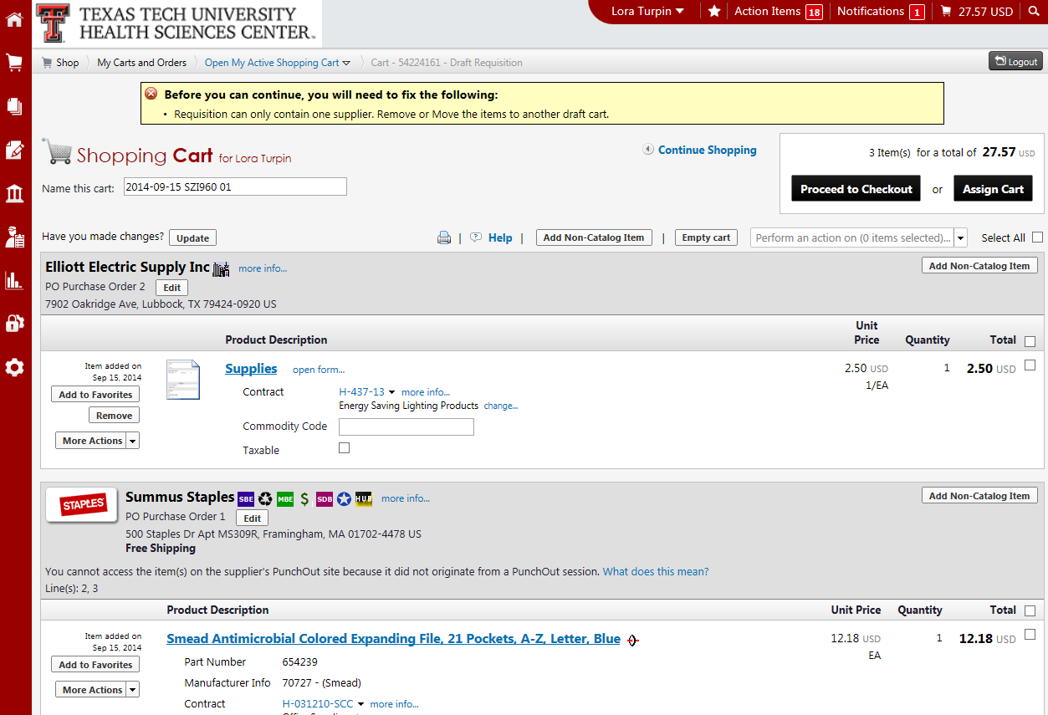
TechBuy Shopping Carts – How to separate two vendors in the same cart. When a shopping cart contains two vendors you will receive the highlighted message below.

Slide 15
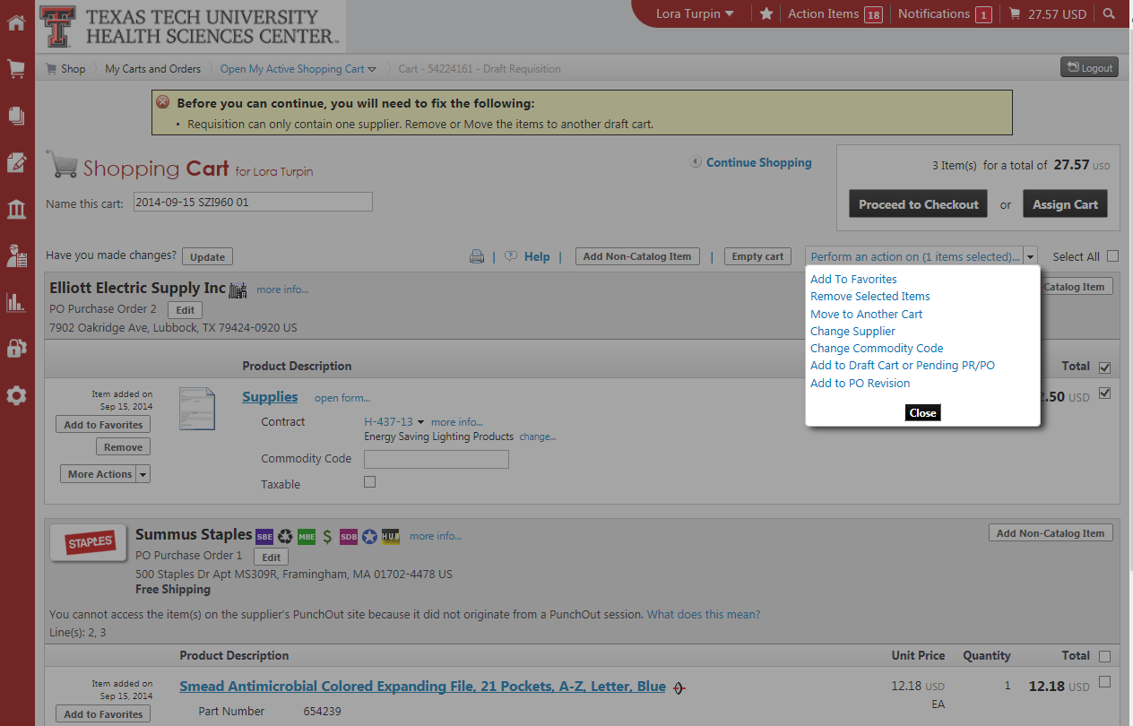
To move items out of the cart: select items to be removed by checking the box on right hand side. From the perform an action box, select move to another cart.
Move to another cart
Items to be removed

Slide 16
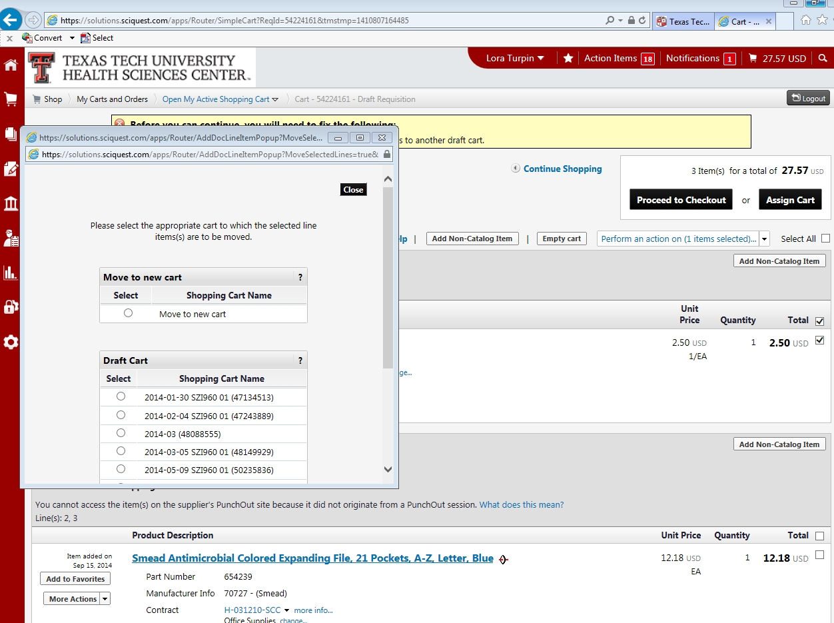
Select move to new cart or add to an existing draft cart.
Move to
new cart
Select draft cart

Slide 17
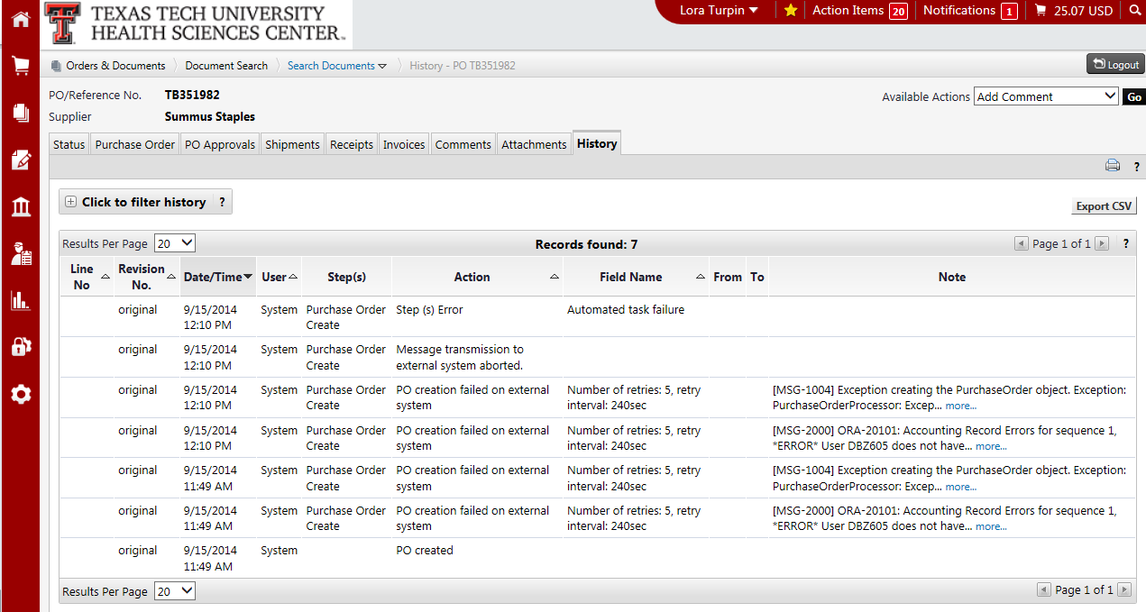
History Tab
The history tab is used to track changes made to the requisition or PO. The history tab also shows errors if the order is failing.

Slide 18
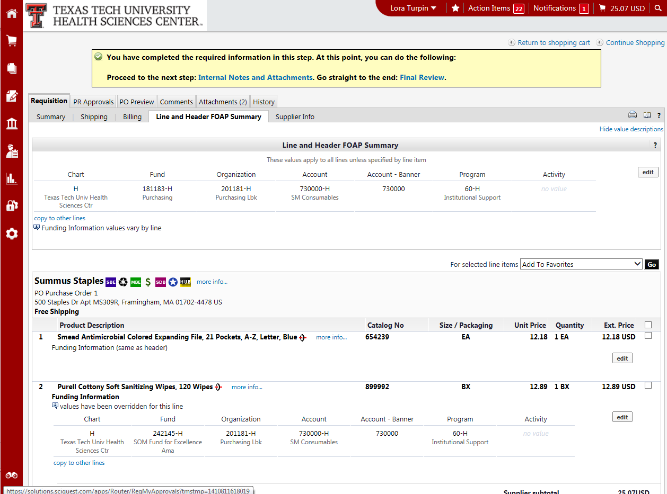
Funding Splits
To create a split of funds in TechBuy the split must be at the line item. We are unable to split the order at the header.

Slide 19
To split at the line item select the line and header FOAP Summary tab. Next, scroll to the line item that requires the FOAP change and click edit.
Select Line and Header FOAP Summary
Select edit

Slide 20
Change FOAP information or click add split to add additional FOAP’s.
Change FOAP
Add split

Slide 21
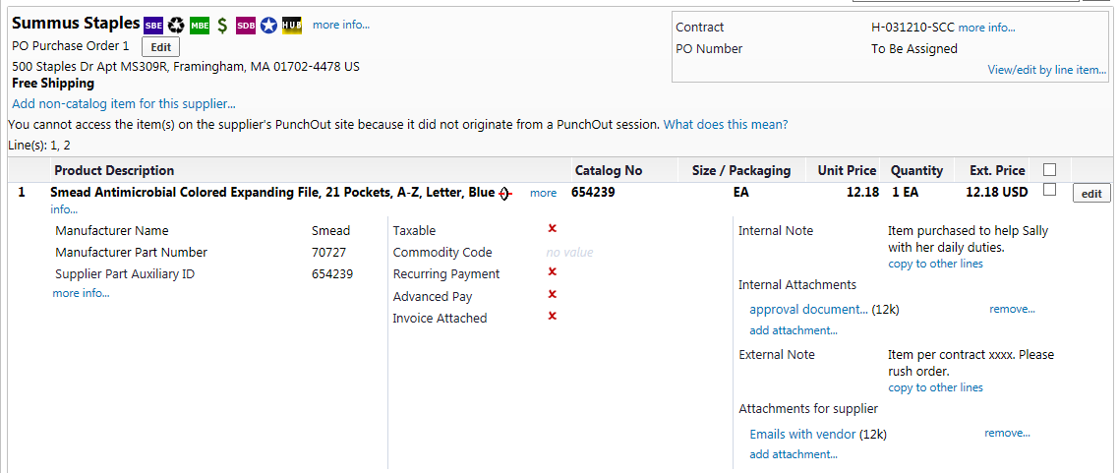
Advance Pay/Recur Payments
To request an advance or recur payment check the appropriate box at the line item.
First, click the edit button on the right side of the line item.
Click edit

Slide 22
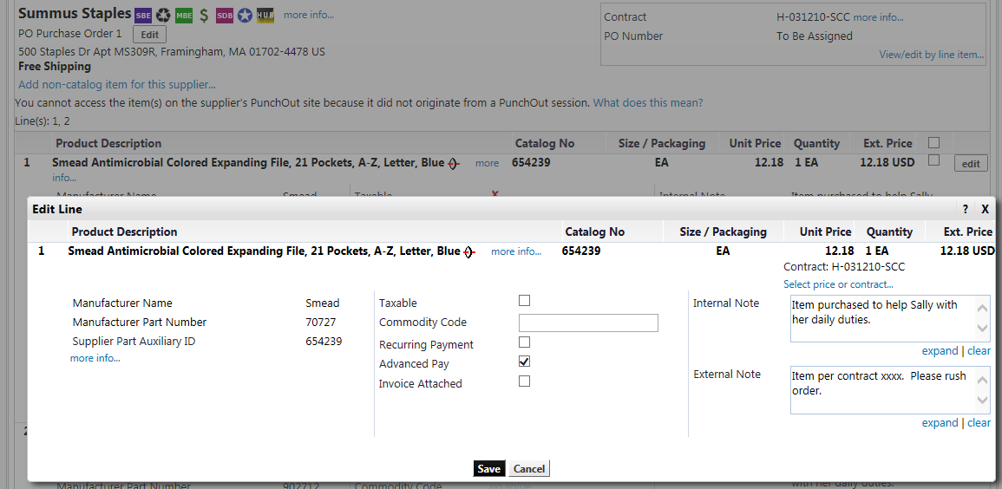
Click appropriate box and a check mark will appear.
Click box

Slide 23
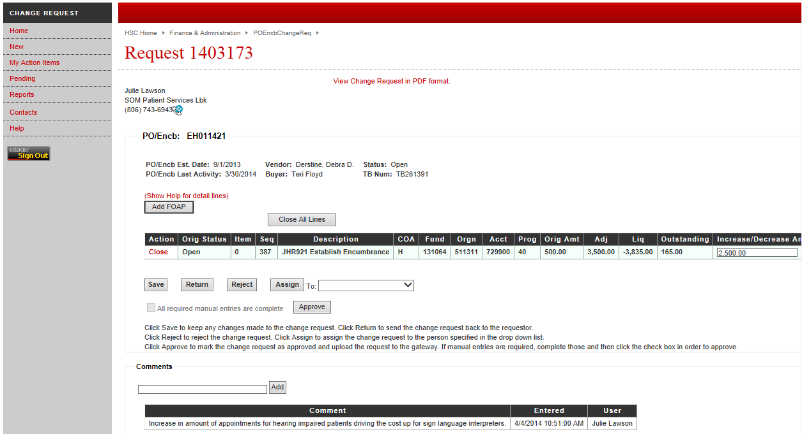
Change requests
The comment section of the change request is provided for the department to communicate with purchasing why they are requesting this change. Please make sure to be descriptive and explain the change request.
Comments

Slide 24
Direct Pay Forms in TechBuy
COMMON ISSUES THAT DELAY PROCESSING:
Select proper account code for the transaction. If there is not a form with a specific title (i.e. freight invoice, rental of space/booth) the transaction must be processed with a TechBuy PO.
Required documentation is not being attached – in the future the requisition will be returned to the preparer. This will require the Fund Manager to approve again.
Make sure the supplier/vendor and the remit address needed is available. If the “remit to” address is not available – enter the information manually.
Do not process an employee reimbursement if the transaction from the employee is over 60 days old. This reimbursement must be processed through EOPS.
Contact information is as follows:
Accounts.Payable@ttuhsc.edu
Payment Services 806-743-7826

Slide 25
Questions ?

